Slide 1
Two-Level Translation Lookaside Buffers
L1 miss, look up in L2
If found, insert the entry into L1
L2 miss
OS goes to
page table
L1 Private
flush all upon process switching
64 entries
L2 Shared for multiple processes
selective flushing
For 1 process
256 entries
For 1 process
256 entries
For 1 process
256 entries
For 1 process
256 entries

Slide 2
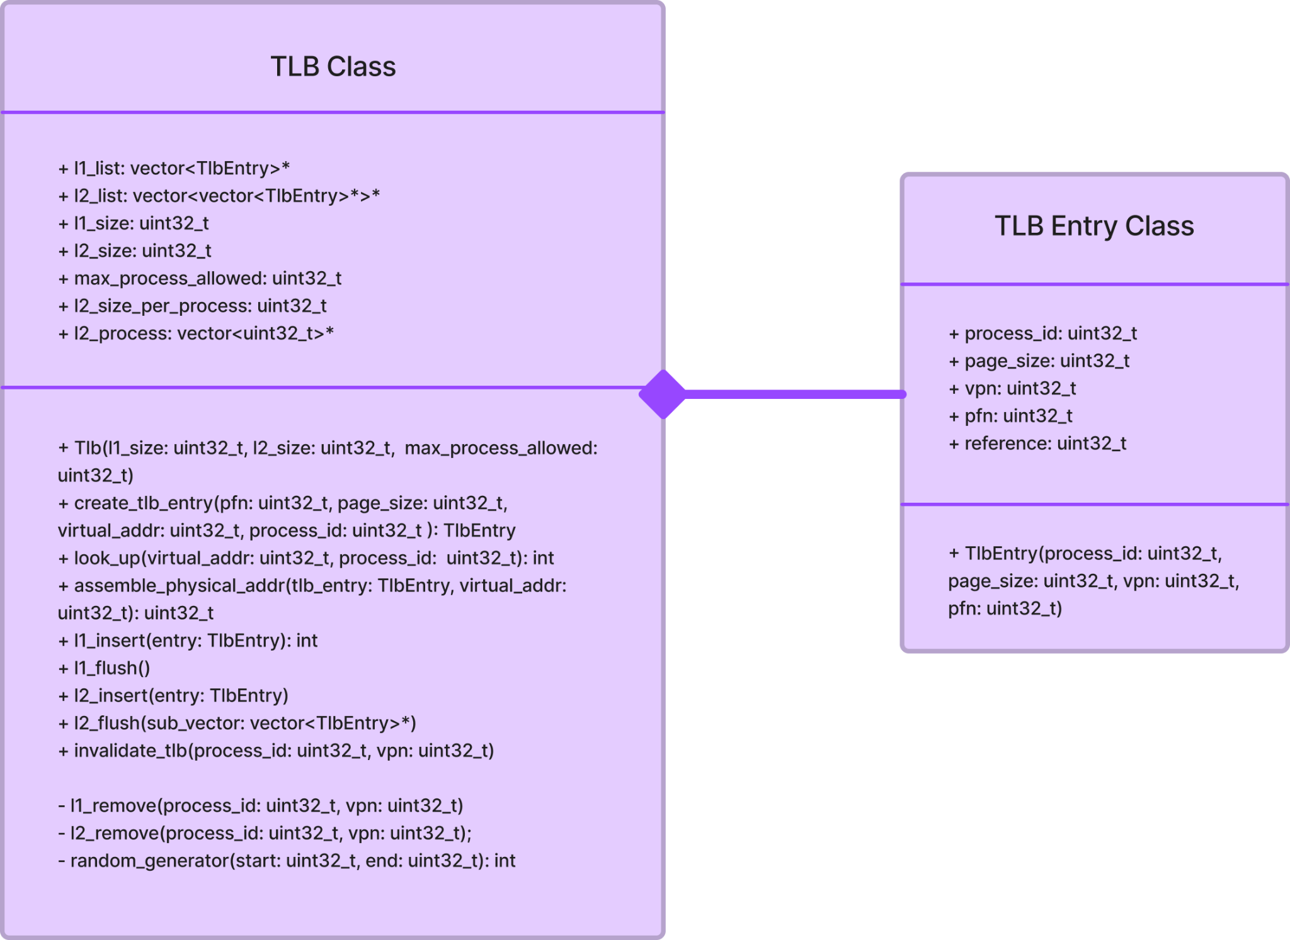
TLB
Main functionalities for TLB
Look up
Insert
Flush
Invalidate (remove)
Assemble physical address
Users can modify
L1 and L2 sizes
Number of processes allowed in L2

Slide 3
TLB Replacement Policies
Current replacement policies:
Random
FIFO

